Slide 1
Neural Substrates of Attention and Awareness
Dan Birman
Gardner Lab
Kalanit Lab Meeting – 2015-02-06

Slide 2


Notes:
Show animation, then go back and repeat: asking to attend to background (21 total black dots move, 22 with the first)

Slide 3
Notes:
Show animation, then go back and repeat: asking to attend to background (21 total black dots move, 22 with the first)

Slide 4
Attention as a Pre-Requisite to Awareness
Dual task designs often “pull” attention to one task, causing inattentional blindness for other stimuli.
“we believe […] there is no conscious perception without attention” (Mack & Rock, 1998)
Mack & Rock, 1998

Slide 5
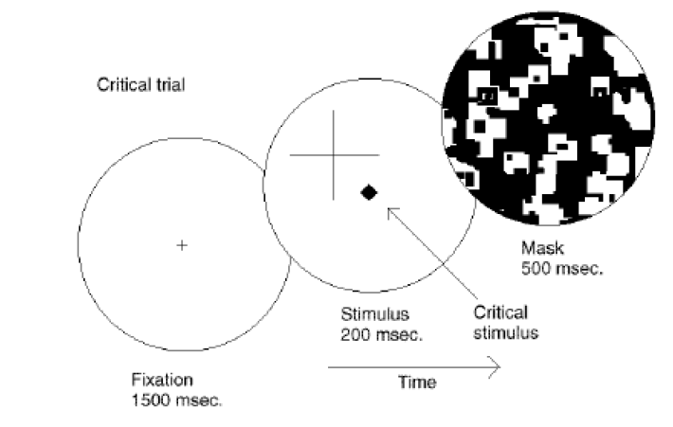
Attention as a Pre-Requisite to Awareness
Dual task designs often “pull” attention to one task, causing inattentional blindness for other stimuli.
“we believe […] there is no conscious perception without attention” (Mack & Rock, 1998)
Mack & Rock, 1998
Notes:
There is one situation where attention (seems) to not be a pre-requisite for awareness

Slide 6
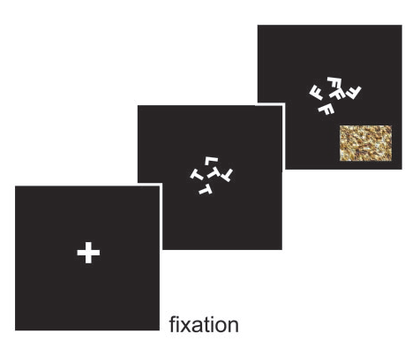
Gist Perception
Li et al., 2002
Reddy et al., 2004

Slide 7
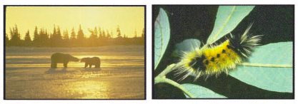
Gist Perception
Li et al., 2002
Reddy et al., 2004

Slide 8
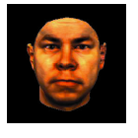
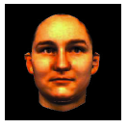
Gist Perception
Li et al., 2002
Reddy et al., 2004

Slide 9
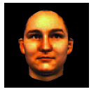
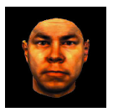
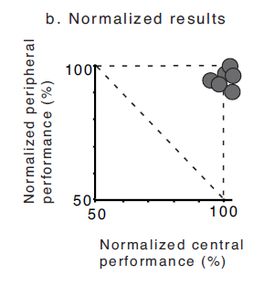
Gist Perception
Li et al., 2002
Reddy et al., 2004

Slide 10
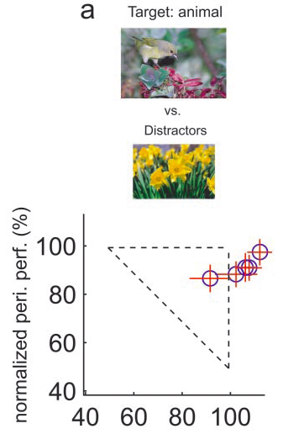
Gist Perception
Li et al., 2002
Reddy et al., 2004

Slide 11
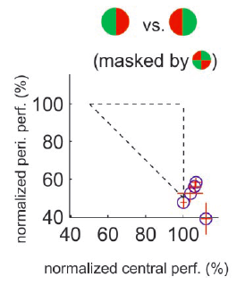
Gist Perception
Li et al., 2002
Reddy et al., 2004
Notes:
Note the whole story… what if the central task was not difficult enough? Or maybe it didn’t “interfere” with the other task?

Slide 12
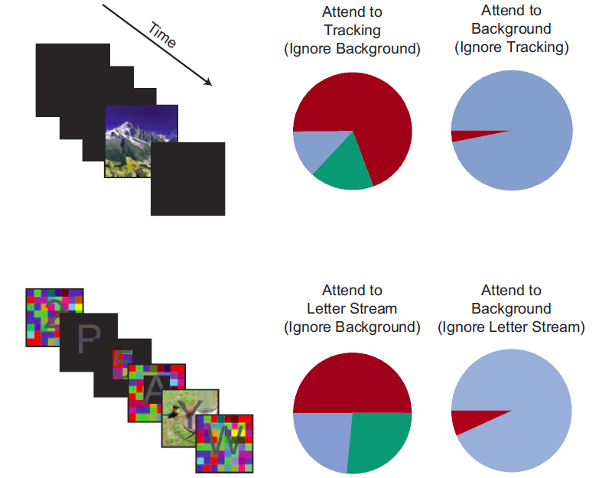
Gist Perception: Impossible Under Load?
Blind
Classified
Saw
Cohen et al., 2011
Notes:
Some tasks DO interfere enough to inhibit awareness. No awareness without attention. So is attention the precursor to awareness?

Slide 13
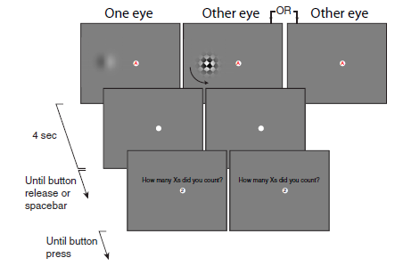
Attempts to Dis-Entangle Attention/Awareness
Dual Task Designs where attention is crossed with awareness. How does a dependent measure, e.g. afterimage length, depend on these factors?
van Boxtel et al., 2010
Notes:
Maybe attention is a pre-cursor to awareness. How might we show that? One idea is to dissociate attention and awareness.

Slide 14
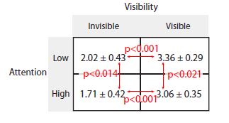
Attempts to Dis-Entangle Attention/Awareness
Afterimage Length (s)
van Boxtel et al., 2010

Slide 15
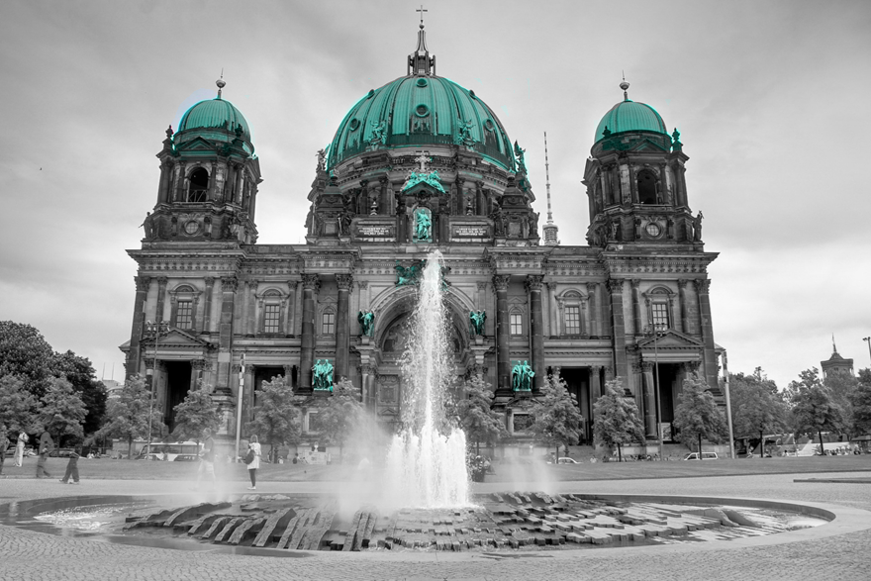

Operational Definitions vs. Neural Activity
http://www.globeimages.net/data/media/180/berlin_cathedral_front.jpg
Notes:
So far we’ve run on the assumption that ‘attention’ and ‘awareness’ are two “things” that we intuitively understand. Attention guides and awareness brings into our perception. But what if this model is incorrect? Attention is a neural process and so is awareness. To understand how attention and awareness interact (if they do) we should look to computational modeling. As an example, think about what happens when you focus on “teal” in the image.

Slide 16
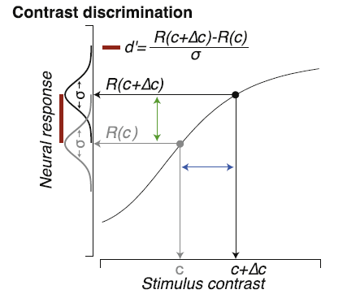
Identifying Neural Substrates
Pestilli et al., 2011

Slide 17
Identifying Neural Substrates
Pestilli et al., 2011

Slide 18
Identifying Neural Substrates
Pestilli et al., 2011

Slide 19
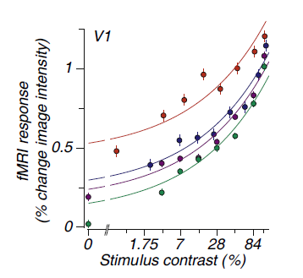
Identifying Neural Substrates
BOLD Magnitude
Pestilli et al., 2011

Slide 20
Identifying Neural Substrates
BOLD Magnitude
Pestilli et al., 2011

Slide 21
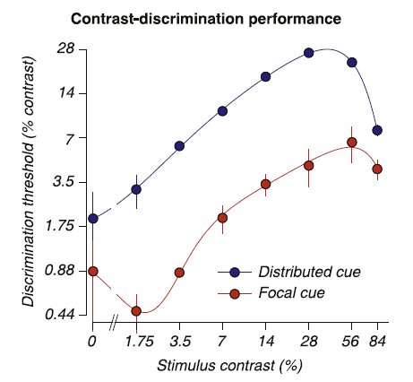
Identifying Neural Substrates
Behavioral Performance ←→ BOLD Magnitude
Pestilli et al., 2011

Slide 22
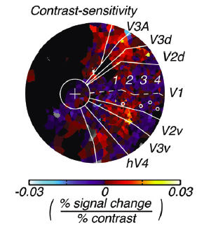
Feature Dependent Neural Substrates
Hara et al., 2014
Tjan et al., 2006

Slide 23
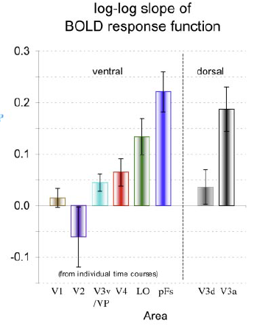
Feature Dependent Neural Substrates
to objects
in noise
Hara et al., 2014
Tjan et al., 2006

Slide 24
Conceptual Overview: Attention & Awareness
“Recent research has slowly corroded a belief that selective attention and consciousness are so tightly entangled that they cannot be individually examined.” (van Boxtel et al. 2010)
Instead of focusing on dissociating attention and awareness, we should be focused on understanding their neural substrates.
Attention: Local feature-specific modulation of neural activity
Awareness: A downstream process, dependent in an uncertain manner on attention.
Computational Modeling:
Notes:
First attempt: dual

Slide 25
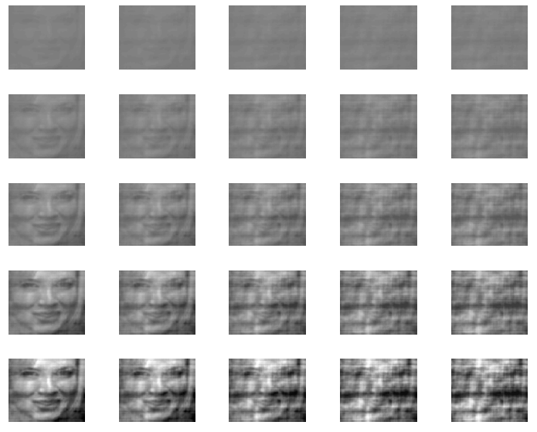
Separating Selective from Spatial Attention
Contrast
Noise
Notes:
Spatial attention causes a robust boost in activation in that region, does feature attention operate in a similar way? Feature attention may be robust (e.g. for scenes) even when spatial attention is deployed elsewhere. We should be careful to separate these in our experiment.

Slide 26
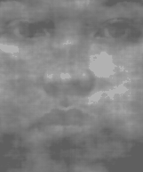
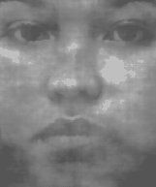
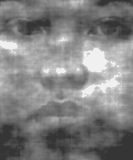
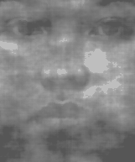

Notes:
Discriminate contrast OR noise: spatial attention crossed with feature attention, which is important for awareness?

Slide 27
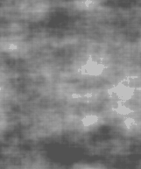
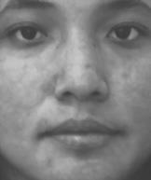
Notes:
High (dual) vs. Low (single) task conditions. Expectation: During dual task contrast/gender will have better performance than noise/gender, because noise attention is more feature-based than contrast which is more spatial.

Slide 28
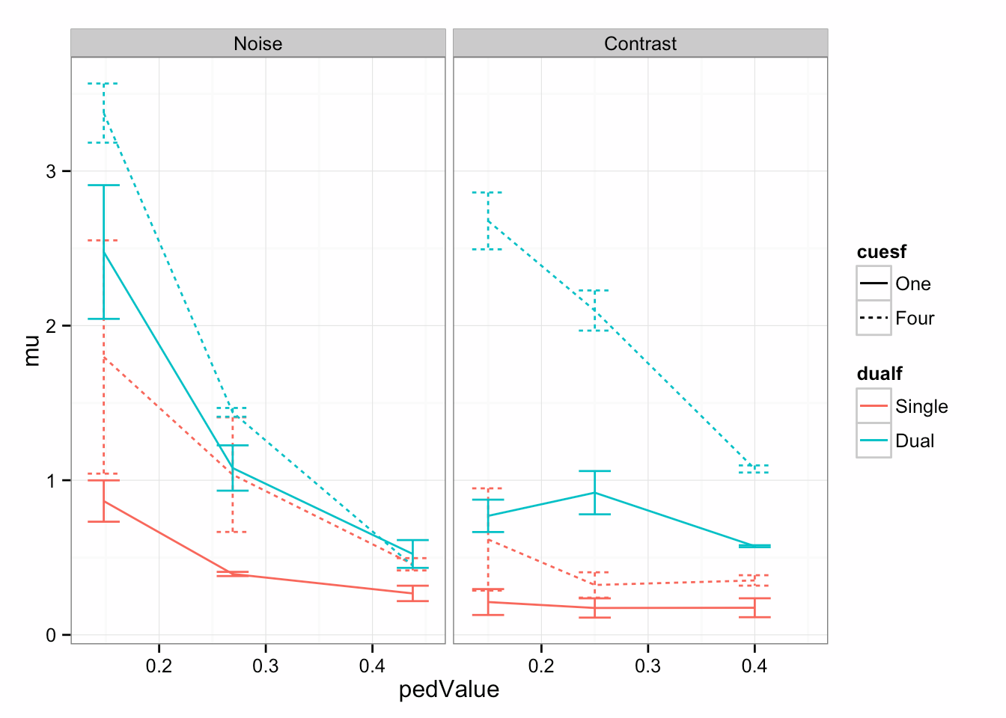
Attention * Awareness
Notes:
Remember to talk about your prediction: noise + gender = worse performance, contrast + gender = better performance

Slide 29
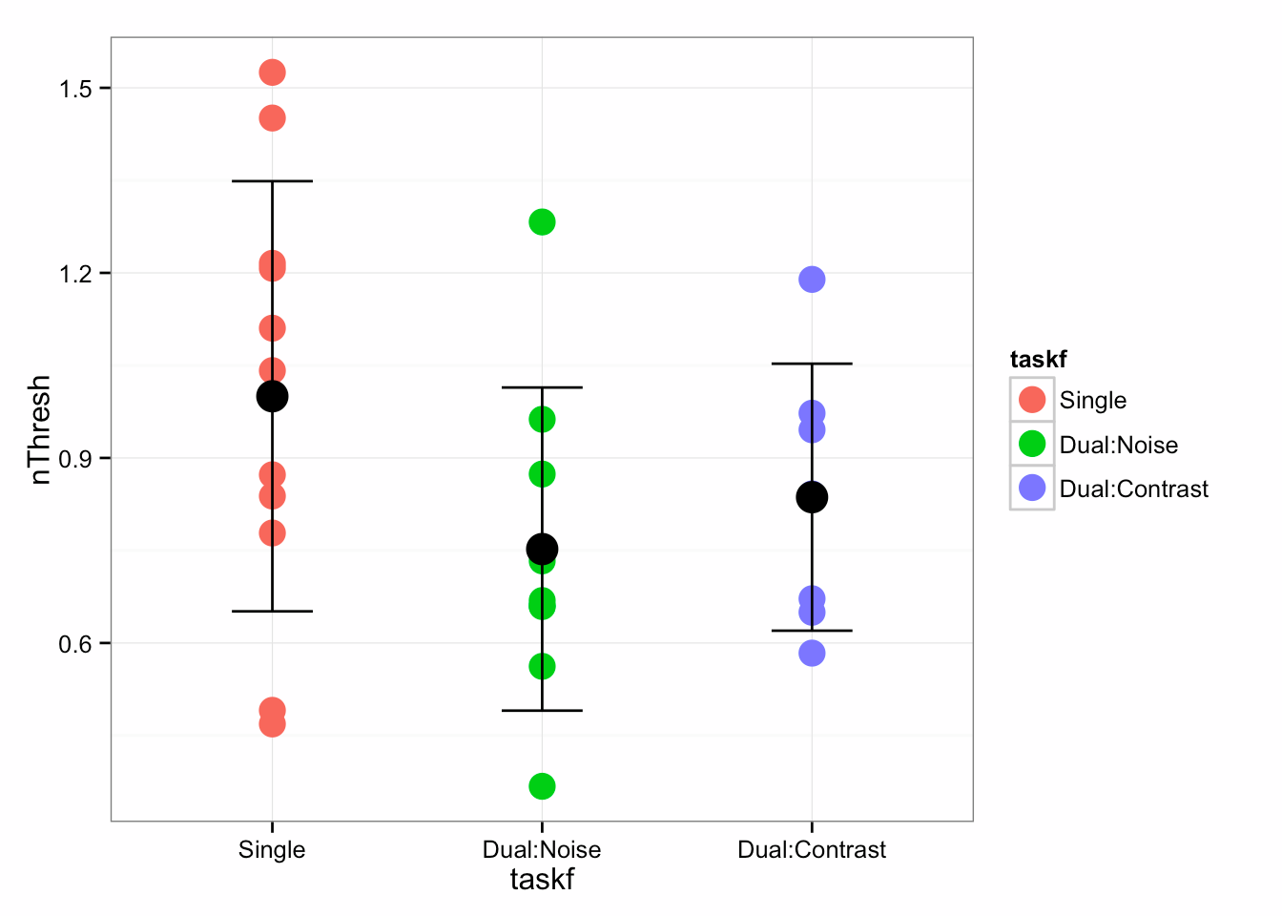
Attention * Awareness
Notes:
Gender same across all categories

Slide 30
Dual Task Issues
Difficulty: Previous Slides contain >10,000 trials (7s per trial)
Cross-task Comparisons (noise threshold vs. contrast threshold?)
Cross-task interference: Hard to control which task is the ‘main task’ and which task has deteriorating performance.
Bottom-up vs. top-down attentional effects

Slide 31
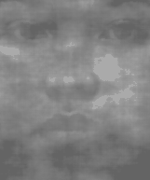




Possible solution: Graded Change Blindness?
Less prone to bottom-up attentional effects
No training required
Signal detection rather than forced choice discrimination: allows for a measurement of “awareness” in the direct sense.
Still separates effects of spatial and feature attention on awareness.
Catch trials: Measuring awareness
In the absence of top-down attention
Notes:
We really care about top-down attention

Slide 32
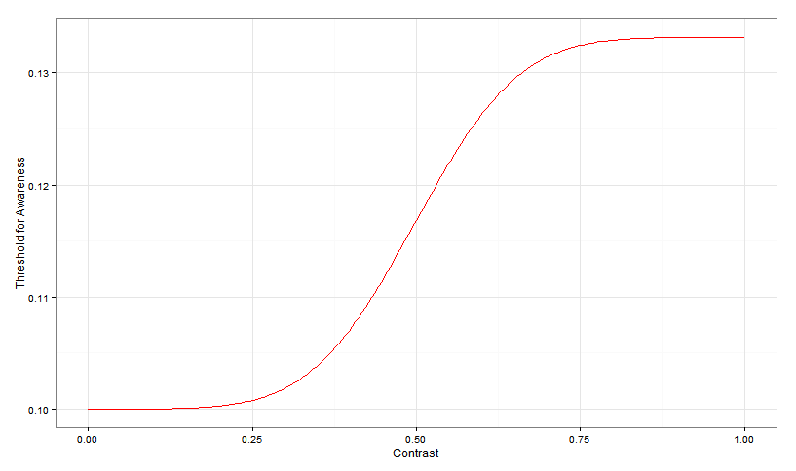
Expectations
Ped C

Slide 33
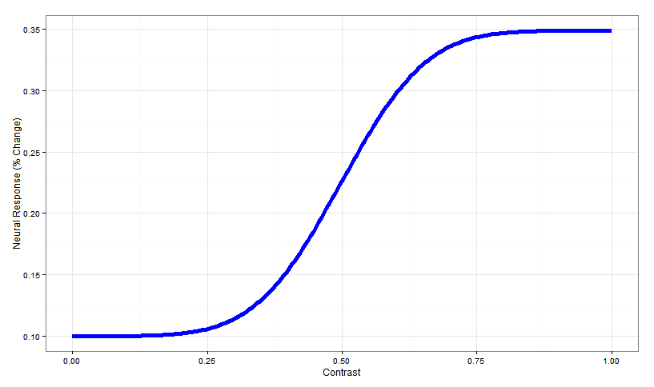
Expectations
Ped C

Slide 34
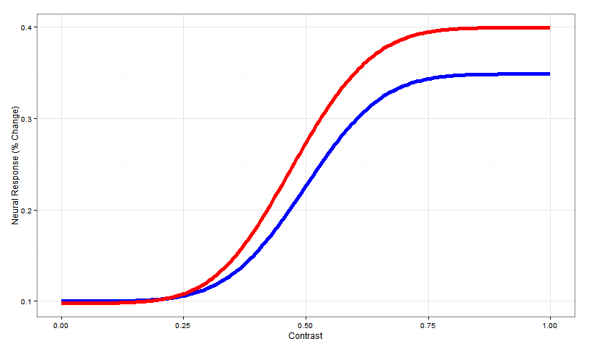
Expectations
Change in slope
due to attention
Ped C

Slide 35
Expectations
Can a (plausible) model of awareness, as a function of neural activity, capture the behavioral results in dual tasks?
Or do we need additional steps to explain how awareness can occur in the absence of “attention” (e.g. spatial attention) in some circumstances and not in others?
Change in slope
due to attention
Ped C

Slide 36




Gardner Lab @ Stanford University
Justin Gardner
Steeve Laquitaine
Thanks for your attention and awareness!

Slide 37
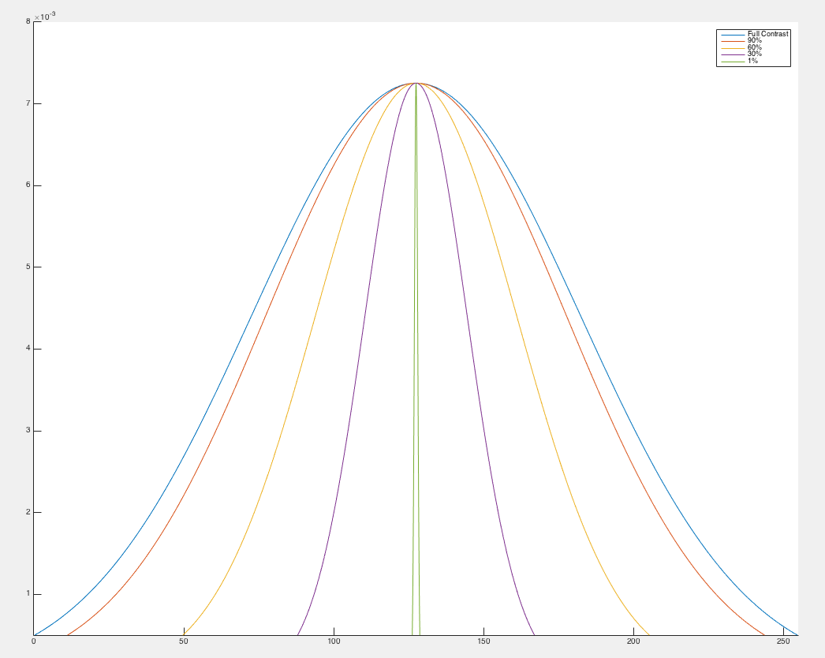
Manipulating Contrast

